Slide 1
Costs of passive rewilding in Barcelona: A Monte Carlo simulation experiment
Dario Schulz (dario.schulz@efi.int)
10.03.2025

Slide 2
Motivation
Agricultural abandonment leads to natural regrowth
Could be good for forest biodiversity but risky for wildfire severity
Biomass (BM) under future climate scenarios
Short-term: increased fuel (dead biomass)
Long-term: decreasing fuel (limited BM growth)
Management options:
Passive BAU (business as usual, no intervention)
Active SAL (salvage logging to remove dead biomass)
RQ: What are costs and benefits of BAU vs. SAL?

Slide 3
Method (in a nutshell)
Deterministic
Speed rate and direction of fire spread under BAU and SAL
Affected land use/land cover
Probabilistic
Ignition location
Uncertainty
Houses (ha-1), value of houses, labor costs for logging, revenue from salvage logging, costs of fire-fighting per ha (…)
Net present value of BAU vs. SAL:
Costs/Benefits of SAL intervention (logging)
Costs/Benefits of BAU (houses destroyed, increased fire-fighting)

Slide 4
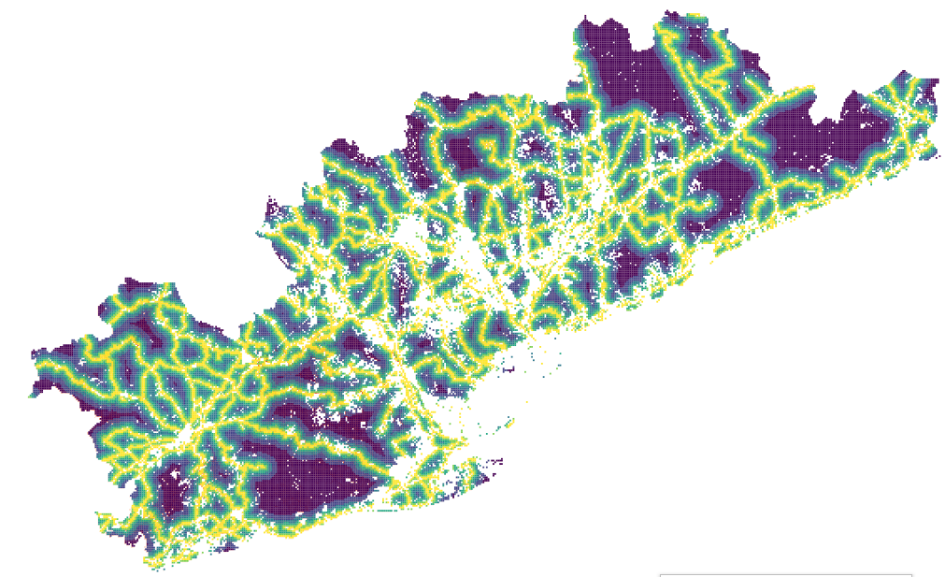
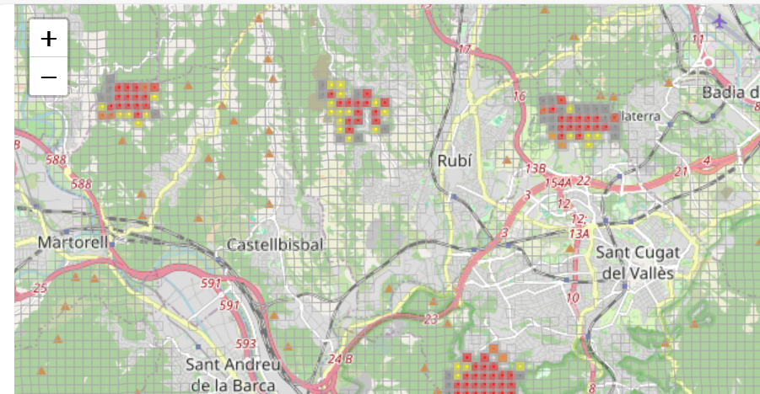
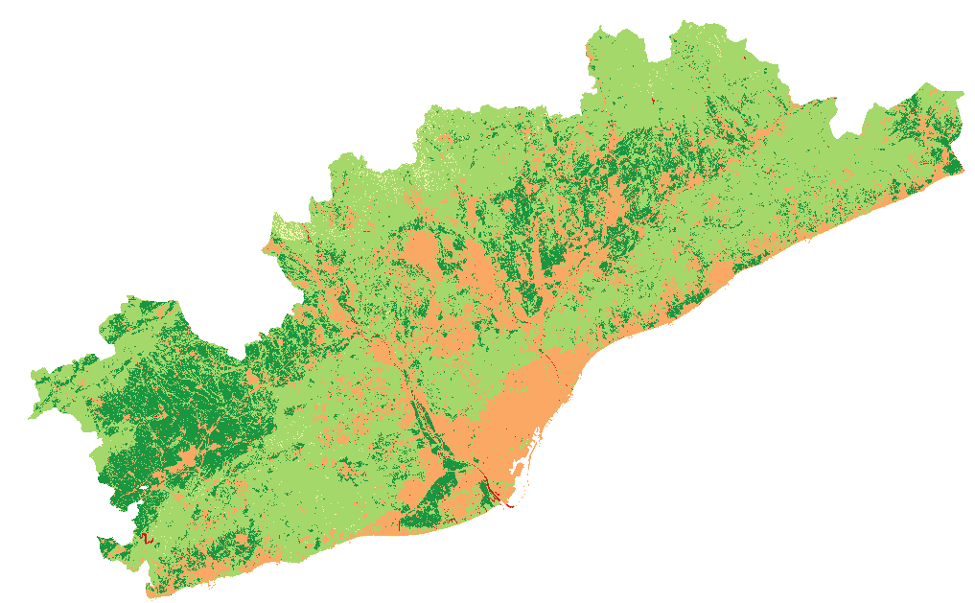
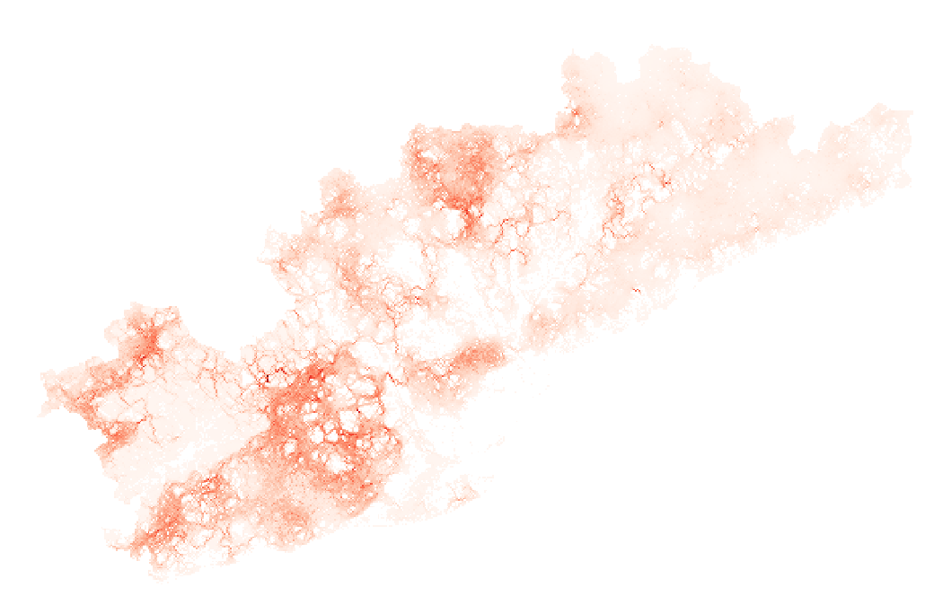
Method Part I
Ignition probability
Affected landcover classes (ha)
Biomass, Fire connectivity (BAU, SAL)
Time T0
Time T1
Monte Carlo simulation

Slide 5
Method Part II: A (too) simple cost estimation
Scenario {BAU, SAL}
# houses on urban land [ha⁻¹]
Price of house [€]
Benefits SAL = ∑ Costs_{BAU} - ∑ Costs_{SAL}
Affected land cover {urban, agriculture, shrub/forest}
Total assets destroyed
Fire fighting costs [€ ha⁻¹]
Total shrub/forest area [ha]
Direct Labor costs of SAL
Net present value SAL
Salvage logging costs [€ ha⁻¹ ]
Parameter | lower | Upper | distribution
time_horizon | 36 | 36 | unif
houses_per_ha | 1 | 20 | unif
house_price | 20.000 | 100.000 | lnorm
agric_land_price | 4.000 | 18.000 | Posnorm
fire_fight_cost_per_ha | 60 | 2.000 | Posnorm
salvage_logging_cost_per_ha | 1.750 | 2.150 | Posnorm

Slide 6
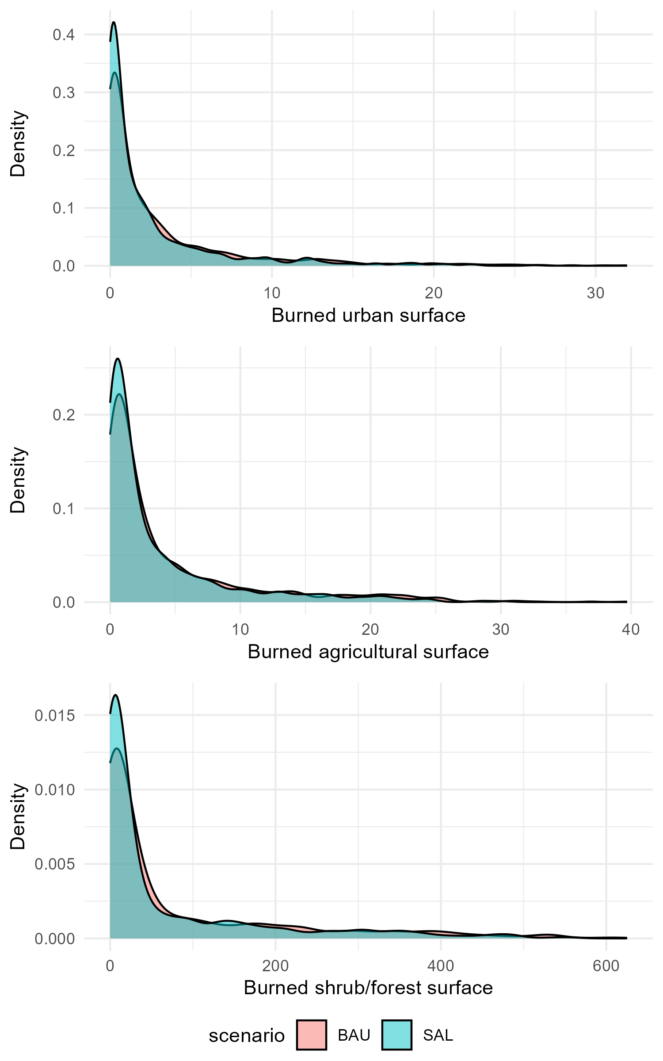
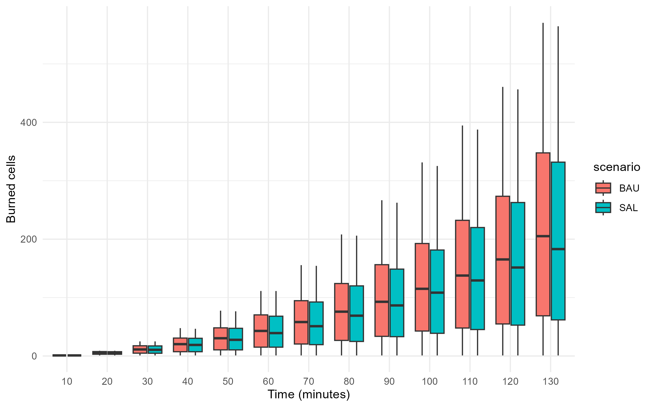
Results I (preliminary)
Total burned cells over time across scenarios for 1.000 random ignition points
Figure 3: Distribution of affected landcover classes [ha]

Slide 7
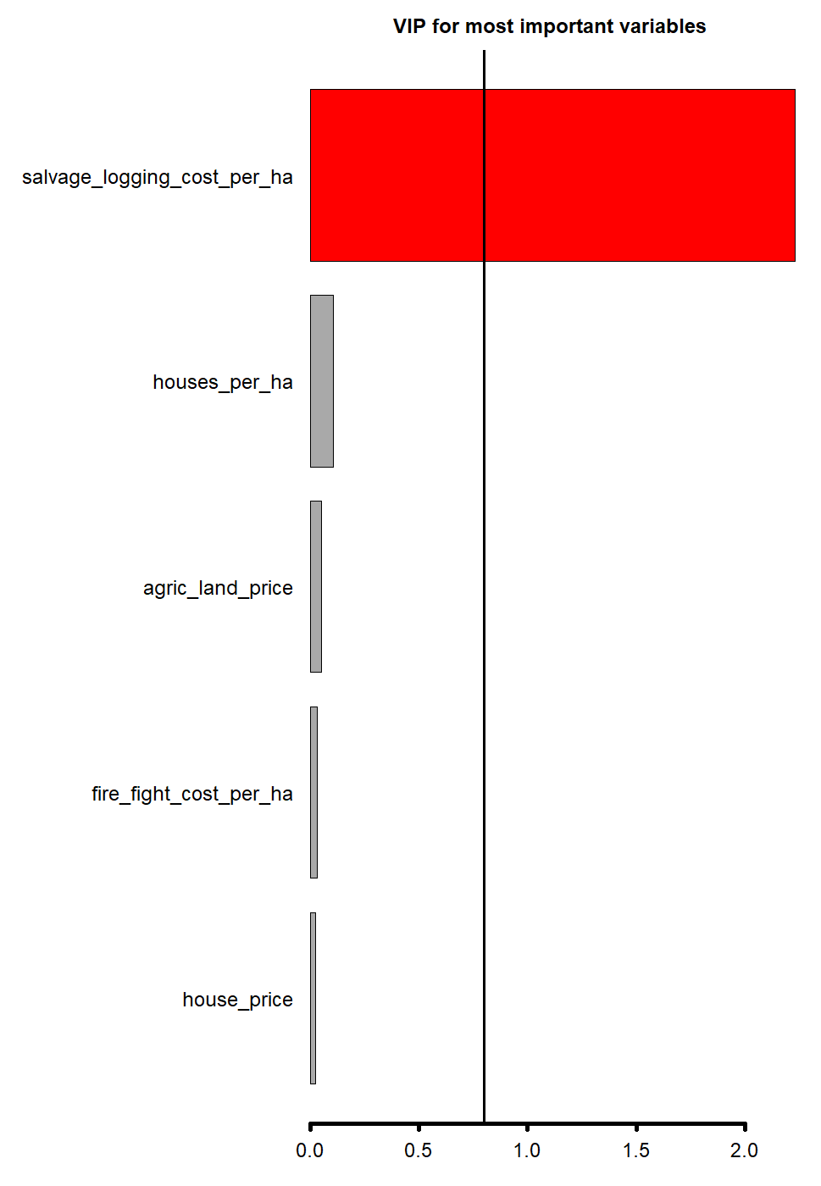
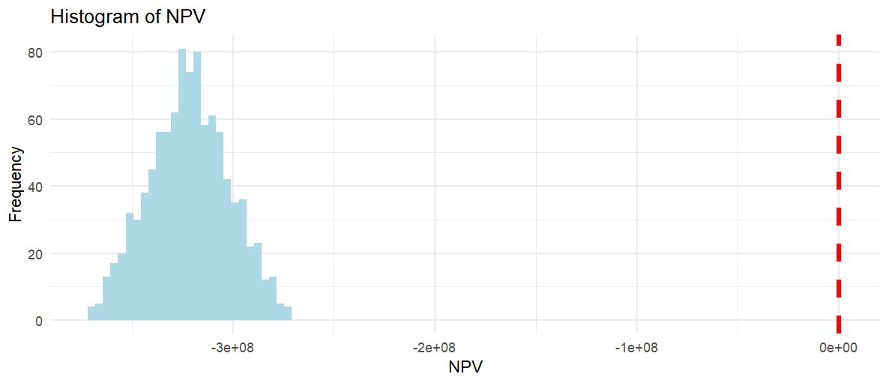
Results II (preliminary)
Distribution of estimated net present value of SAL on entire area from 1.000 Monte Carlo simulations
Variable importance

Slide 8
Spatial targeting scenarios
X% (e.g. 1%, 5%, 10%) of pixels with highest biomass/connectivity
H: should reduce average area burned
Potentially inaccessible areas, i.e., higher logging costs
X% of pixels with highest road / settlement proximity
H: should reduce cost associated to burned area
Other?

Slide 9
Temporal considerations
Timeframe of single event (currently: 3h)
Fixed vs. variable (makes it harder to compare)
Timeframe of simulation / analysis
Number of events per year
If small, can we consider events (i.e., rate of spread etc.) as independent?
Does SAL affect ignition probability (measurably)?
Propagation of (burned) biomass into subsequent years very uncertain

Slide 10
Next steps
Cost estimates from firefighters
Incl. frequency/duration of events
Variable vs. fixed costs
What simulation would they be interested in from practical pov?
Validation data for fire spread
Burned area of past events along with their duration?
Framing w/o rewilding? (include benefits?)
Target audience/journal?
Improve simulation: spread velocity to diagonal neighbors should be /sqrt(2)

